Slide 1
PORT DEVELOPMENTS, MARITIME CITIES AND LOGISTIC CORRIDOR PROJECTS
OF THE
WESTERN PROVINCE MEGAPOLIS PROJECT
17th September 2017
D.E.C JAYAKODY
Project Director
WESTERN REGION MARITIME CITY DEVELOPMENT PROJECT
MINISTRY OF MEGAPOLIS AND WESTERN DEVELOPMENT

Slide 2
AIM
TO APPRAISE YOU WITH REGARD TO THE LOGISTIC CORRIDOR, PORT RELATED AND MARITIME CITIES PROJECTS IN THE PIPE LINE, AND IN THE DEVELOPMENT STAGE BY THE MARITIME CITY DEVELOPMENT PROJECT UNDER THE PERVIEW OF MINISTRY OF MEGAPOLIS AND WESTERN DEVELOPMENT

Slide 3
SEQUENCE
RECREATION BEACH / WATER FRONT PROJECT COLPETTY TO DEHIWALA CANAL OUTLET
YACHT MARINA AT DIKOWITA
LOGISTIC CENTER AND CUSTOM SCANNING FACILITY AT BLOEMENDHAL
LOGISTIC PARK WELISARA
PROPOSED PORT DEVELOPMENTS AND LOGISTIC CORRIDOR
Q & A

Slide 4
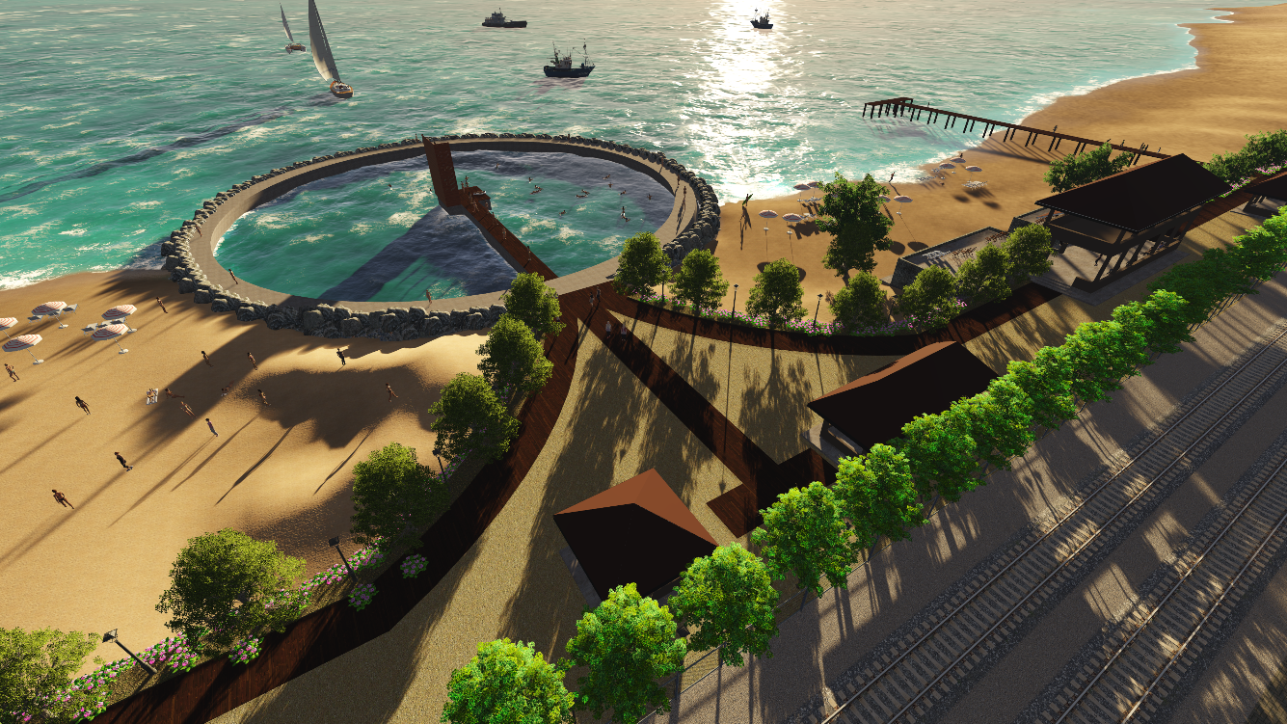
PROPOSED RECREATION BEACH / WATER FRONT PROJECT COLPETTY TO DEHIWALA CANAL OUTLET
RFP
Legal
Designs
Ship Wrecks
Conceptual Plan

Slide 5
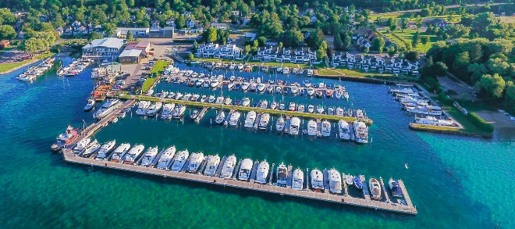
PROPOSED YACHT MARINA AT DIKOWITA

Slide 6
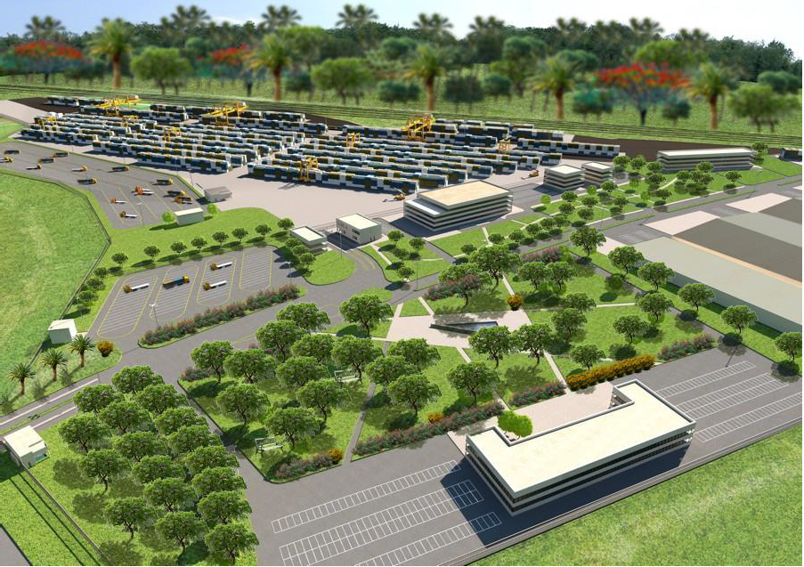
PROPOSED LOGISTIC CENTER AND CUSTOM SCANNING FACILITY AT BLOEMENDHAL
Map
Conceptual Plan

Slide 7
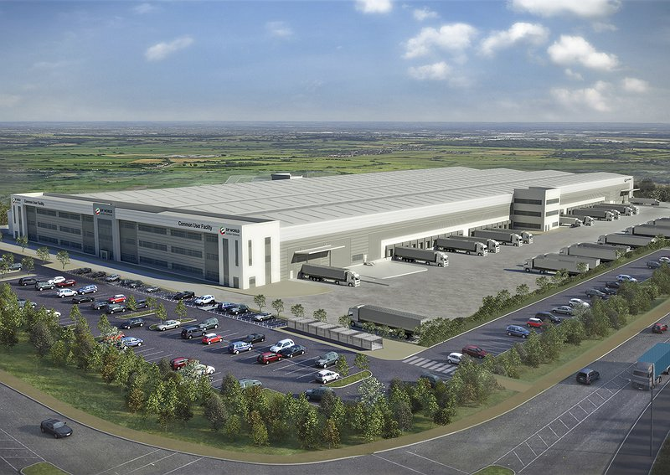
PROPOSED LOGISTIC PARK WELISARA

Slide 8
PROPOSED PORT DEVELOPMENT AND LOGISTIC CORRIDOR
Current and Proposed Port Development Plan
Logistic Corridor Concept Plan
Current and Proposed Connectivity and Transport Pattern
Proposed Development
Proposed Logistic and Industry Development
Proposed Master Plan
List of Action Projects
Logistic Park – Peliyagoda
Logistic Park - Henamulla
Logistic Park – Sumitpura
Logistic Park - Ekala
Multimodal Centre- Ragama
Logistic Park –Meethotamulla

Slide 9
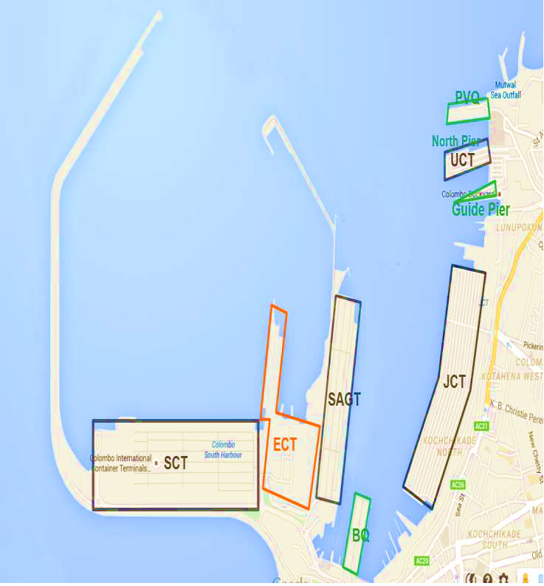
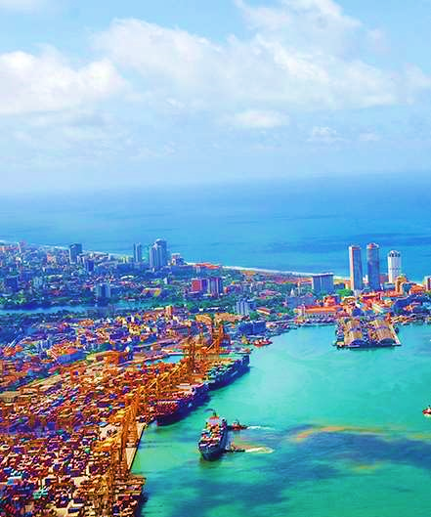
Colombo Port at Present
Container Terminal | Depth (m | Length (m) | Annual Capacity (TEUs)
Jaya Container Terminal | -11.3 to -15.0 | 1200 | 2.45
Unity Container Terminal | -9.0 to -11.0 | 590 | 0.30
South Asia Gateway Terminal | -15 | 940 | 1.95
Colombo South Container Terminal | -18 | 1200 | 2.40

Slide 10
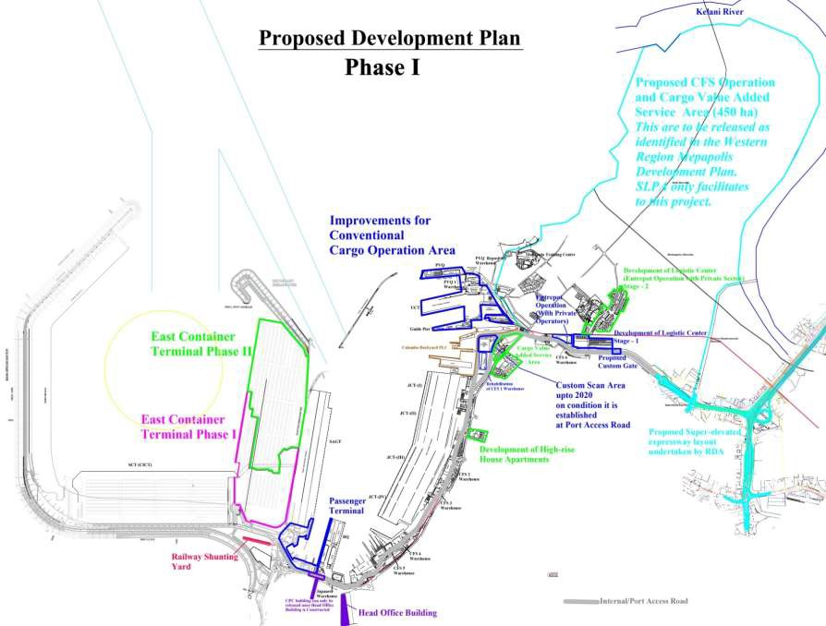
Proposed Port Development
Port Development Plan : Phase 01
❑ Completion of East Container Terminal (ECT)
❑ Commencement of construction of West Container Terminal - I (WCT- I)
❑ Construction of Port and Shipping Business Center
❑ Development of Bandaranayake Quay as a Passenger Terminal
❑ Shifting of conventional cargo to JCT I & II
❑ Establishment of CFS for LCL in JCT I & II
❑ Allocation of SAGT and JCT III & IV for feeder handling
❑ Establishment of Cargo Inspection Facilities close to the Port of Colombo
❑ Development of CFS Operations and Cargo Value added Services in a Land adjacent to Colombo.

Slide 11
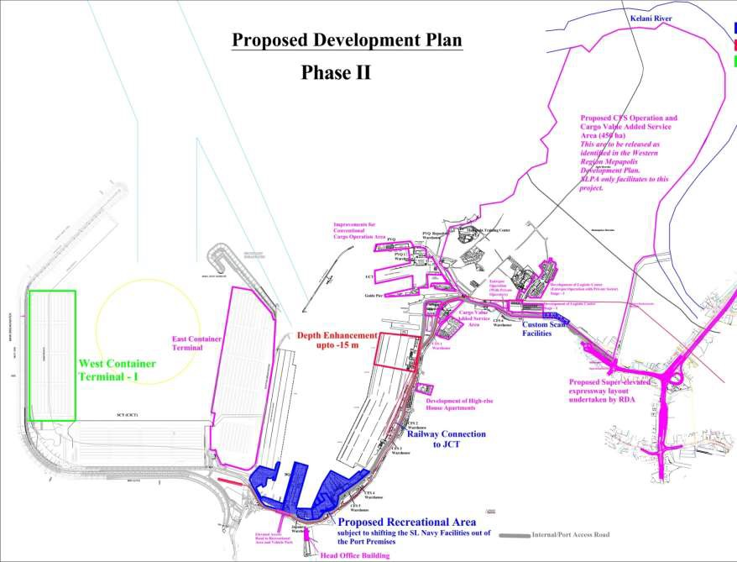
Port Development Plan : Phase 02
Extension of Colombo South Harbour (CSH) Breakwater
West Container Terminal – II
Improvements to UCT, PVQ and Guide Pier for conventional cargo operation
Commercial developments in JCT I & II
Development of Yacht Terminal

Slide 12
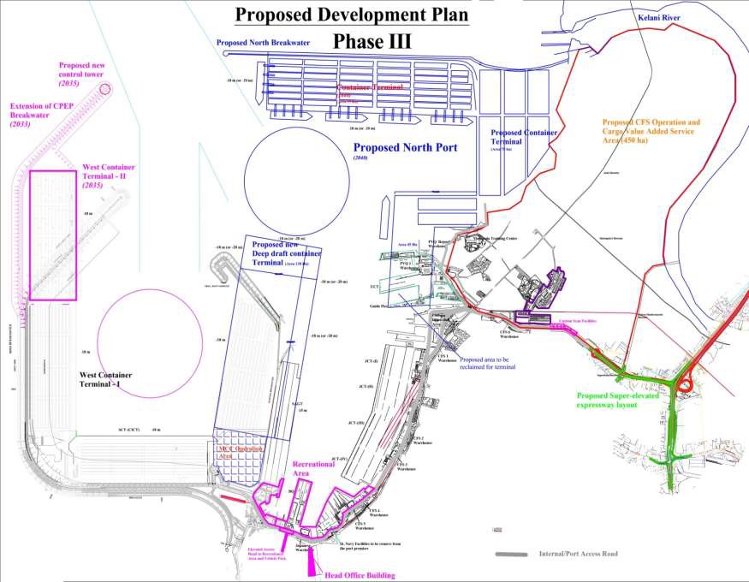
Port Development Plan : Phase 03
Improvements to UCT, PVQ and Guide Pier for conventional cargo operation
Commercial developments in JCT I & II
Development of Yacht Terminal
Development of Colombo North Port A
Development of LNG terminal and Oil berth
Extension of Feeder Handling Area
Real Estate Developments in SLPA Lands around Beira Lake
Construction of High-rise Quarters for SLPA Employees

Slide 13
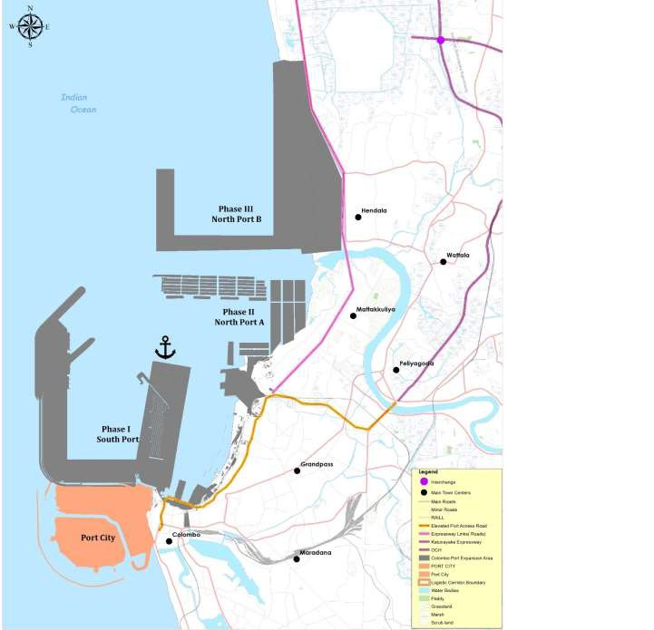
North Port Development : Phase III – Port B
Phase Three includes the CESMA International, Megapolis Plan 2003, ‘New North Port Phase Three’ proposal.
The subsequent phase of the New North Harbour ‘B’ development will involve an area of 350 ha. About 250 ha on new reclaimed land can be dedicated to port related operations and another 100 ha on land side will be for port related commercial and mixed developments.
The proposed reclaimed areas in this phase have the capacity to accommodate 9 main container berths and two feeder berths.
Project Phase | Projected TEU Handling Capacity ( Mn)
Current TEU handling Capacity | 7.1
After completion of WCT extension | 14.3
After completion of ECT – SAGT back to back terminal | 25
If North Port A Implemented | 35
If North Port B Implemented | 50

Slide 14
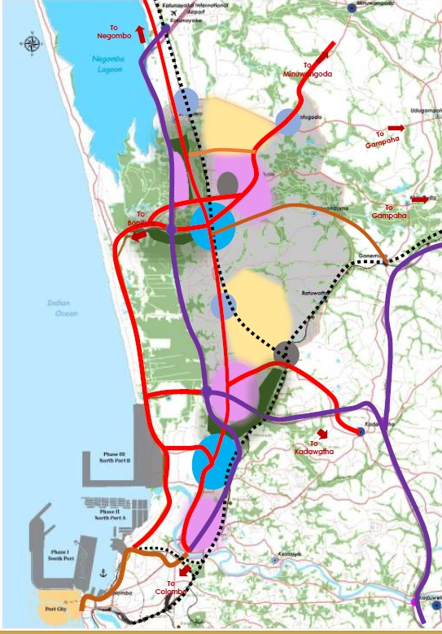
Concept Plan of the Logistic Corridor
Key Strategic Approach :
To build upon its existing port facilities and expand its services to consolidate cargo distribution, transshipment and handling activities
Develop a highly efficient road & Rail network which create easy access & link between Port and logistic centers (including National highways, Expressway Links, Railway links)
Develop specialized large scale logistic clusters.
Develop mini logistics hub with multimodal access.
Expand & density the existing town center to cater to future demand to town centers and other neighborhood centers .
Spread out the High density residential areas to low risk livable areas.
Establish public green /recreational spaces close proximity to high density residential area.

Slide 15
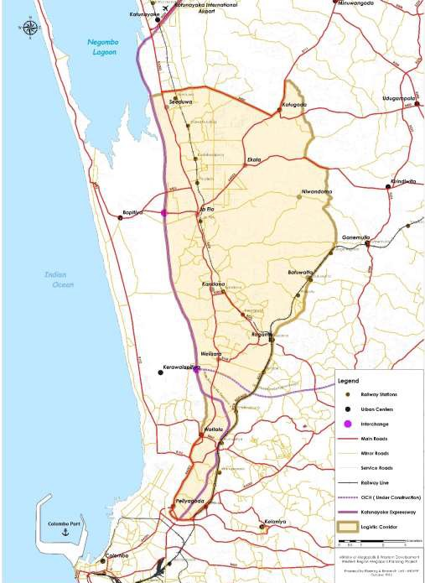
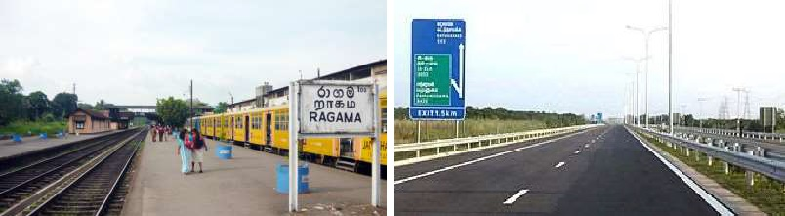
Current Connectivity and Transport pattern
Road transportation is the dominant mode of travel in the Western Region. Roads form the backbone of public transport and connectivity to other modes. Also Railway plays another important role of passenger transportations daily.
Logistic Corridor has directly connected with E 03 – Colombo Katunayaka Expressway, OuterCircular Highway (OCH) from Kerawalapitiya –Kadawatha section which is under construction & Colombo – Negombo Main Road & several Minor Roads which links with main town centers of the area .
Colombo – Kandy main railway line and Colombo – Chilaw Railway Line has gone through the area. Ragama is the key junction of railway from both side which mention above.
Railway play a major role of passenger transportation with adjacent regions such as
Gampaha, Negombo etc…
Most of Interior minor roads conditions are fairly good.
Traffic congestion increased along the Negombo road in peak hours in the morning and Afternoon.
Railway has underutilized in terms of logistic transportation.

Slide 16
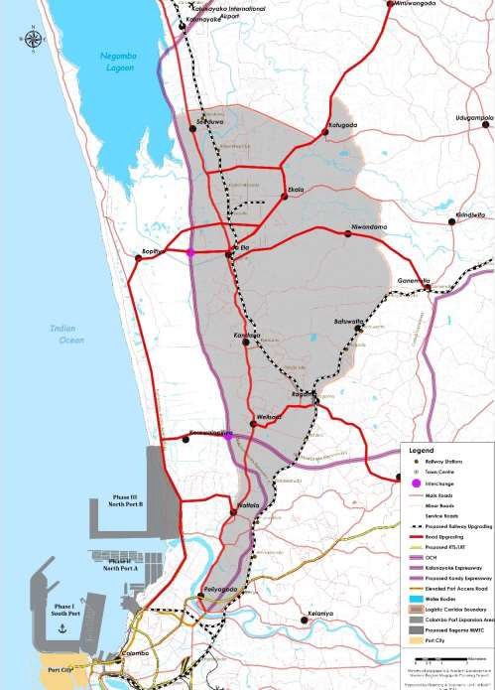
Proposed connectivity Plan
Logistic Corridor between Port & air port has proposed to linked with;
•National Expressway System (E 03 Expressway/ OCH)
•National Railway line ( Colombo –Chilaw / Main Line)
•National Highways ( Colombo – Negombo road)
•Alternative Roads which linked with main urban centers & logistic clusters

Slide 17
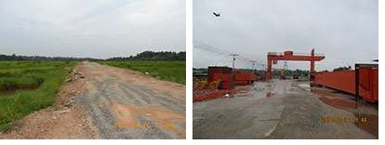
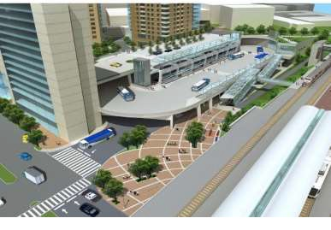
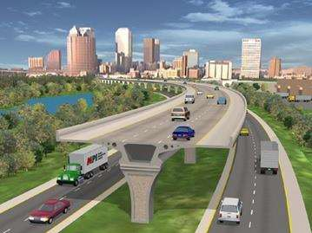
Proposed Expressway Development
Outer Circular Highway (E02) phase III which linkkadawatha & kerawalapitiya has already started theconstruction. It will expected to completion at 2019 June. Total length of this phase is 9.63km and consists with four lane. This will provide more connectivity to the region from down south & north east regions.
Proposed Road Development
It will not adequate lane capacity in the main road corridors where the clusters directly linked. Therefore it is proposed to developed those identified roads with parallel to establishing the logistic clusters. The Aluth Mawatha road which going parallel to Negombo road ; is proposed to upgrade up to 4 lane up to Bopitiya- Ja Ela & this will linked to proposed Ekala Logistic cluster. This will also proposed to link to Kerawalapitiya Interchange & Wattala town center by upgrading additional two link roads. This will divert the traffic from Negombo – Colombo main road.
Proposed Railway Development
WRMP Plan 2030 has identified railway modernization with electrification and the modern system with track improvements, station upgrades and signal system upgrades to attract more ridership for railway. For the purpose of future logistic transportation, the proposed logistic zone area proposed to link with railway line. The feasibility for short distance logistic transportation through railway has to be studied before its operations. From Thudella Station; diversion has proposed to Ekala logistic cluster for multi modal terminal.
Proposed Road Upgrading | Length (Km) (Tentative)
• Aluth Mawatha Road , B152 Road up to Ja Ela, via Bopitiya up to 4 lane road | 21
Kerawalapitiya IC to Bopitiya Road up to 4 lane road | 5
Wattala to Bopitiya road Up to 2 Lane Road | 3
Mahabage – Kadawatha Road up to 4 land road | 11
Ja Ela – Kotugoda B111 road up to 4 lane road | 8
Ja Ela –Ganemulla road via Niwandama up to 2 lane road | 11
Udammita road up to 2 lane | 6
Bopitiya – Ekala Link 2 lane | 9
Proposed Multimodal center
Ragama has proposed to multimodal center development. Railway station play a vital role in passenger transportation daily. In addition to scattered bus terminals and parking facilities will improved.
Proposed Bonded Highway
If there is an easy access between Colombo port and Katunayake logistics area, it will attract major investors in the region. Under this project an elevated highway will be constructed connecting Colombo Port to the Katunayake airport parallel to the existing railway line mainly targeting freight transportation. This will serve only the logistics areas which have been identified in the Megapolis Project and the Port.
.

Slide 18
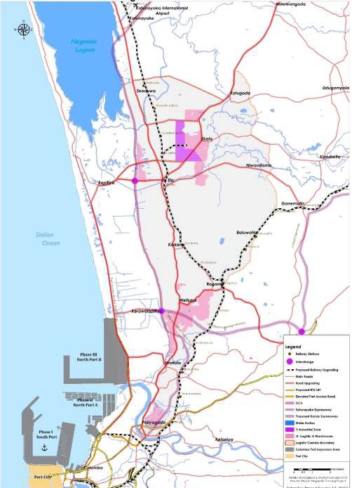
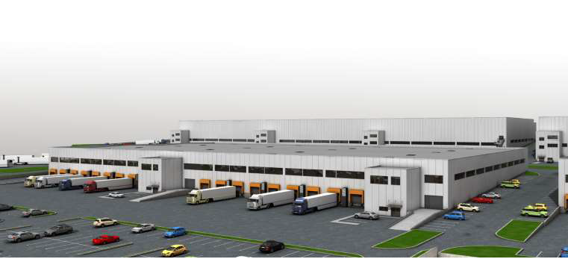
Proposed logistic and industry Development Plan
Proposed Logistic corridor has identified three major clusters for logistic purposes.
Cluster 01 – Ja Ela – Ekala Logistic Cluster
Cluster 02 - Welisara – Mabola Logistic Cluster
Cluster 03 –Peliyagoda logistic Cluster
Analyzing the future development pattern &current logistic operations ;It has identified that the concepts of inland port ; logistic park can be applied in above mentioned areas.

Slide 19
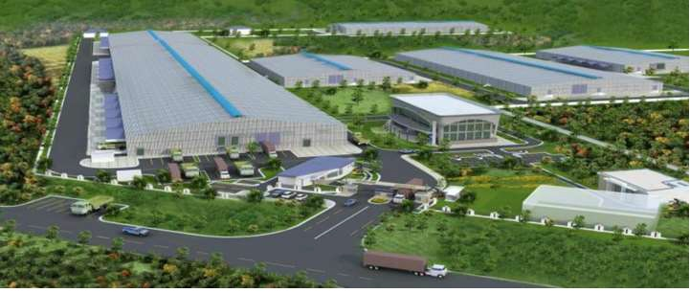
Proposed logistic park has consisted with following key components
Proposed logistic and industry Development Plan
Warehouses
Storage facilities
Container depot,
Cooling facilities,
Freight Forwards Zone;
Consolidation
Light industries (Packing, Sorting & labelling etc., )
Administration Centre
Security Office
Banking ,Financial ,Postal & Communication Service Area
Research & Development Centre
Fuel/Gas Station
Vehicle Maintained Centre- Work Shop (Garage/Service Station Etc…)
Waste Water Treatment Plant
Fire Fighting/ Rescue Facilities
Medical Centre
Education & Training Centre
Parking Facilities
Grid Substation
Hotel, Restaurants
Convention Centre
Railway Terminal /multimodal centre
Container Handling Facility
Security & Custom Clearance facilities
Warehouses / Storage facilities ( Temporary & immediate situations)
Weighing Centre
Office Space
Parking Facilities
Sewerage Pumping Station / Treatment Plant
Strom Water Retention Ponds
Water Treatment Plant / Water Storage Tank
Solid Waste Management Facility Area
The most important infrastructures of Logistics parks are the warehouses and the Intermodal terminal. The warehouse is the infrastructure where the transport operator mostly performs his business. There are different types of warehouses, depending on the activity the transport operator deals with and the freights it handles.
• General warehouses for storage
• Large warehouses (for logistics activities)
• Warehouses with rail-road interchange
• Warehouses with raised docking bays
• Air-conditioned warehouses
• Intermodal Terminal
The intermodal terminal is composed of one or more tracks linked to the main railway arteries and a large area used for dealing with all the train loading and unloading operations.

Slide 20
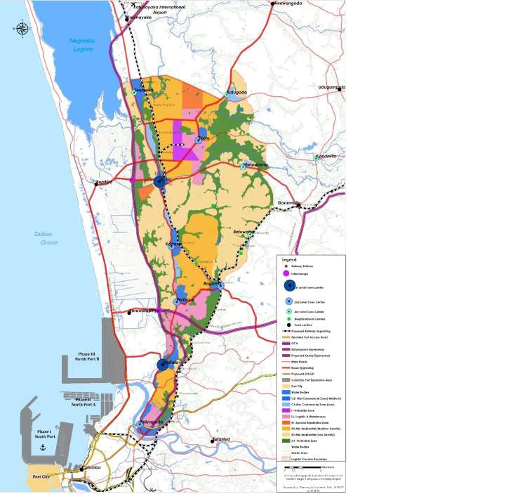
Proposed Master Plan

Slide 21
 | List of Action Projects
Logistic Parks | Logistic Park Development – Ekala/ Ja Ela
 | Logistic Park Development - Welisara
 | Logistic Park Development - Peliyagoda
Commercial center / Township Projects | Ja Ela Town centre development
 | Wattala Town centre development
 | Ragama Town center / multimodal center development
Housing Development Projects | Ja Ela- Ekala middle Income Housing Development ( Phase I - Ekala)
 | Ja Ela- Ekala middle Income Housing Development ( Phase II- Niwasi pura)
 | Ja Ela middle Income Housing Development ( Phase III- Ja Ela )
Infrastructure | Aluth Mawatha Road , B152 Road Upgrading up to Ja Ela, via Bopitiya up to 4 lane road
 | Kerawalapitiya IC to Bopitiya Road Upgrading up to 4 lane road
 | Wattala to Bopitiya road Upgrading to 2 Lane Road
 | Mahabage – Kadawatha Road Upgrading up to 4 land road
 | Ja Ela – Kotugoda B111 road upgrading up to 4 lane road
 | Ja Ela –Ganemulla road via Niwandama Upgrading up to 2 lane road
Infrastructure
Projects
Mabima Water supply Project
Ja Ela - EkalaWaste Water Treatment Project
Waste Water Treatment Plants for Ragama and Peliyagoda town centres
Wet land Park Development ( Ja Ela, Seeduwa, Ragama, Wattala, Niwandama)

Slide 22
Logistic Park Peliyagoda
10 Acres for middle income housing project
18 Acres for mixed development

Slide 23
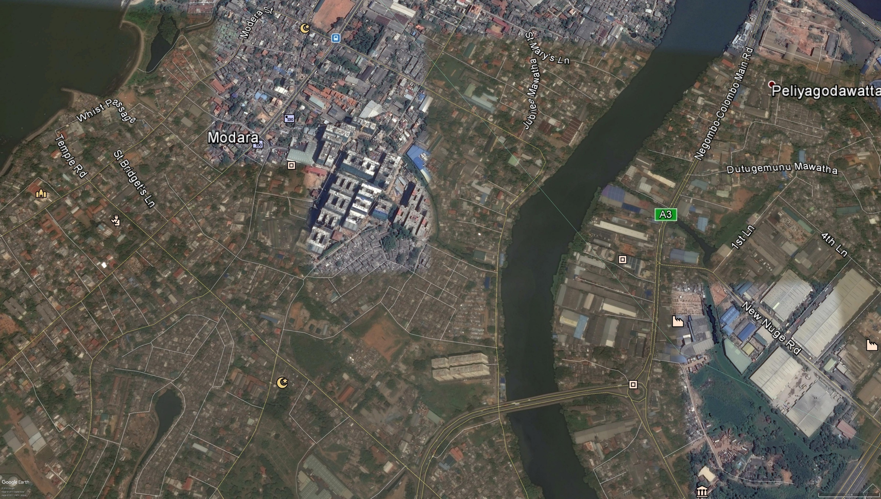
Henamulla Mix Development
Play
ground
Food City
Salvation
Army
Future Land Use
Ware
House
HNDE
Area | Size
Dispensary | 0.68 A
CMC Sewerage pumping station | 12.10 A
Mix Development (Henemulla camp) | 22.20 A
Play Ground 01 | 2.00 A
Mix Development (133 watta) | 3.32 A
Parking Space | 1.20 A
Apartment
Ware
House
Aluth Mw Housing
Project
Re Housing
Modara ananda
Vidyalaya
JEDB Land
Play Ground
HNDE Hostal
Agrarian
service
project 01
Henamulla
Housing
Project
Church
Children’s
Park
Agrarian
service
project 02
Ceylon Oxygen
Limited
Parking
Dispensary
.68 A
Mix
Development
22..2 A
Kelani
River
Temple
Greater Colombo waste water
management project
12.10 A
Play
Ground
2 A
Canal Reservation
Furgusion Housing Project
Mix
Development
3.32 A
CMC Sewerage
pumping station
7.32 A
Sanken
2.40 A
Henamulla
Master Plan
Sri Sangabodhi
Maha Vidyalaya

Slide 24
Layout Plan for Proposed Mixed Development Area-HENAMULLA
Rehousing land extent : 22.2 A
Road network will use 20 feet roads
For parking facilities : 3 A
Common Area : 2 A
Mix development purpose : 19.5 A
2.2 A
2.5 A
1.4 A
2 A
1.5 A
2.2 A
1 A
2.4 A
3 A
2.8 A
2 A
1 A
Parking Facilities
Common Area
Road Network
Mix development Area

Slide 25
Master plan for Samitpura

Slide 26
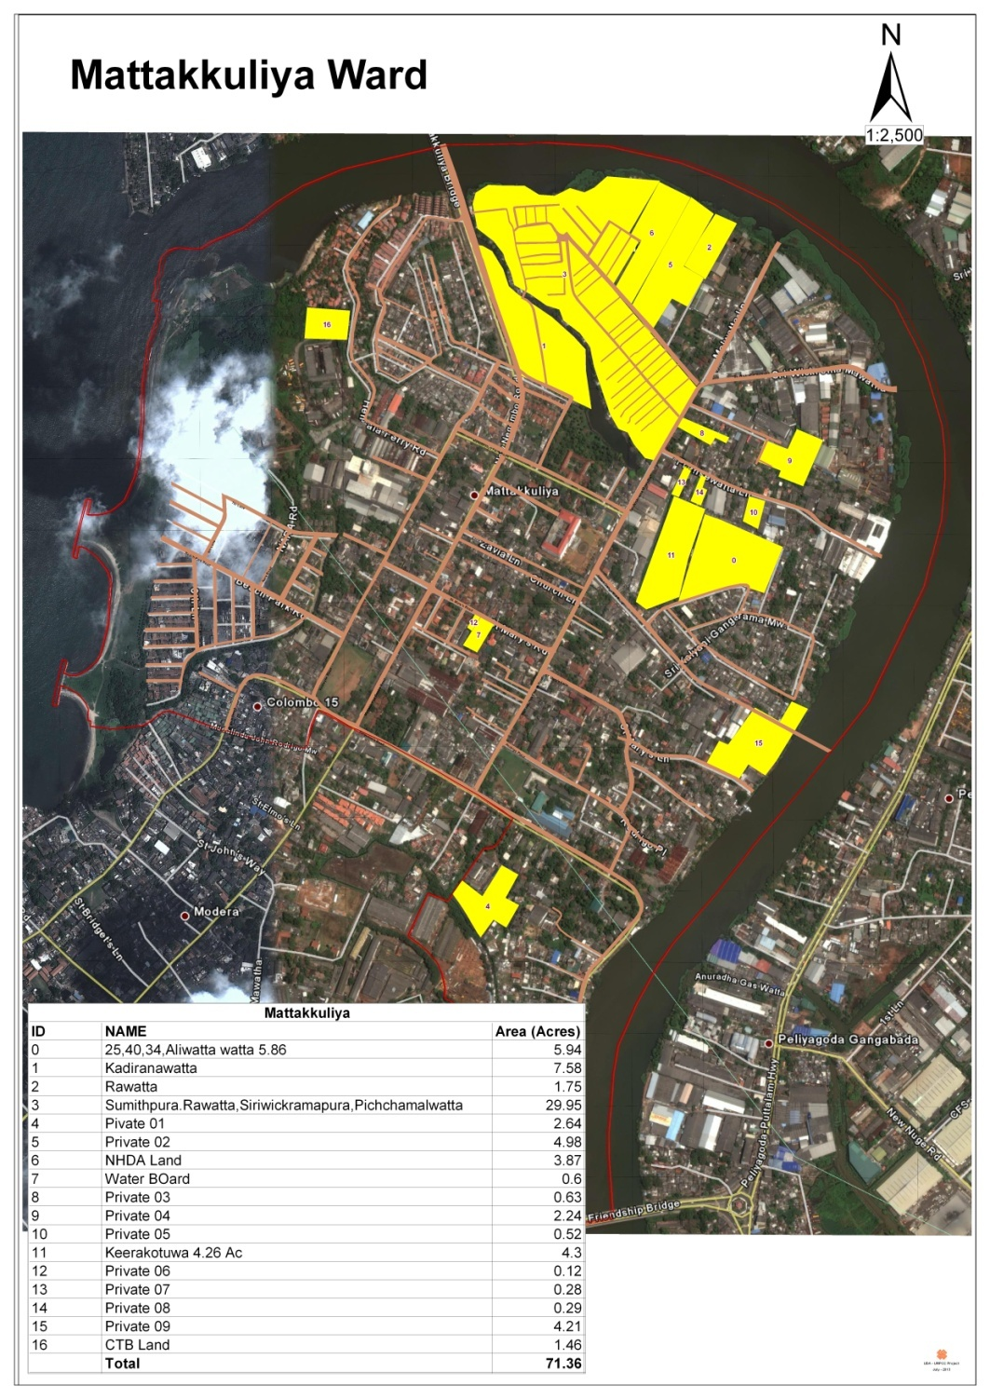
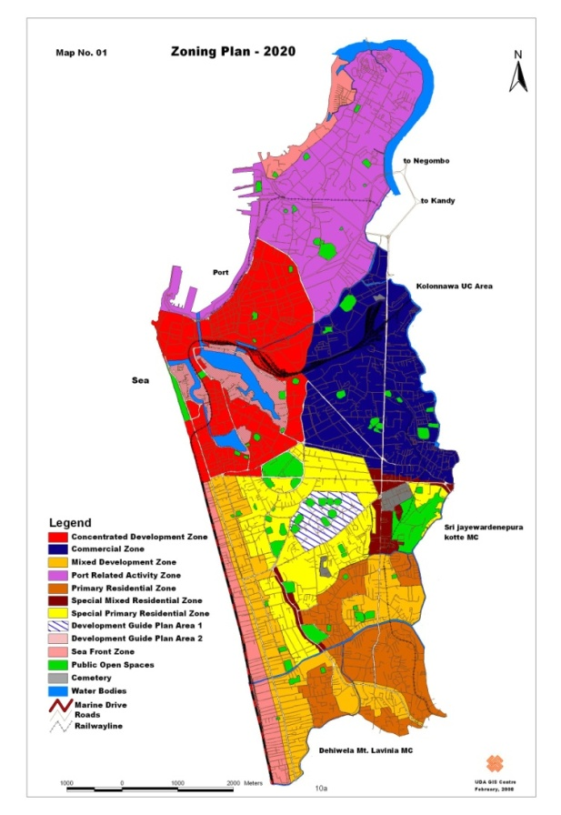
This land located in Mattakkuliya ward.
It is nearly 1.5km away from the beach
The total extent of land area is 35.64 acres with the Samitpura, Pichchamalwatta, Gamunupura ,Sriwikramapura and Rawatta .
Those lands belongs to port related activity zone.

Slide 27
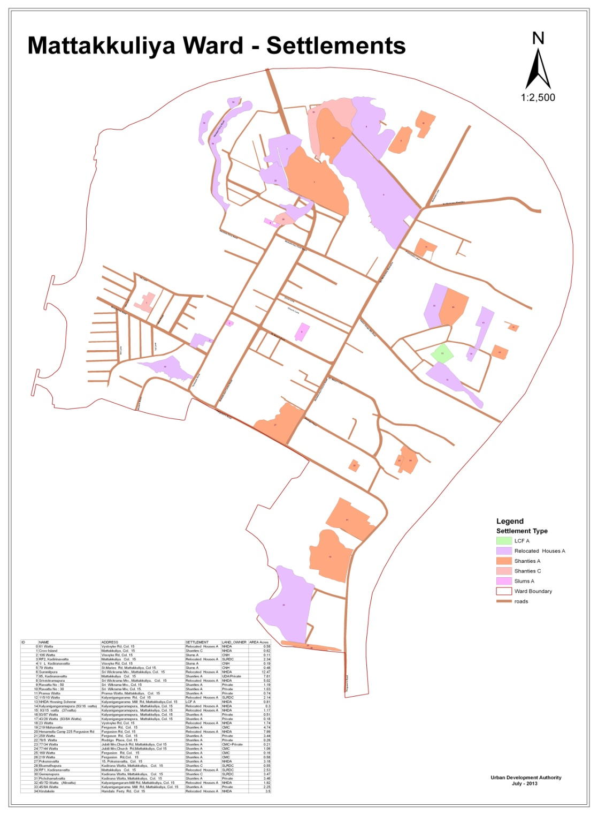
Master Plan Study Area
Planning boundary of Henemulla planning area is situated based on near to Kelani river
Existing infrastructure facilities
Water, drainage and sewerage facilities are available
12ft-15ft width road system
Key significant features
Total land area is about 30 Acres and one side of the land bounded from the kelani river

Slide 28
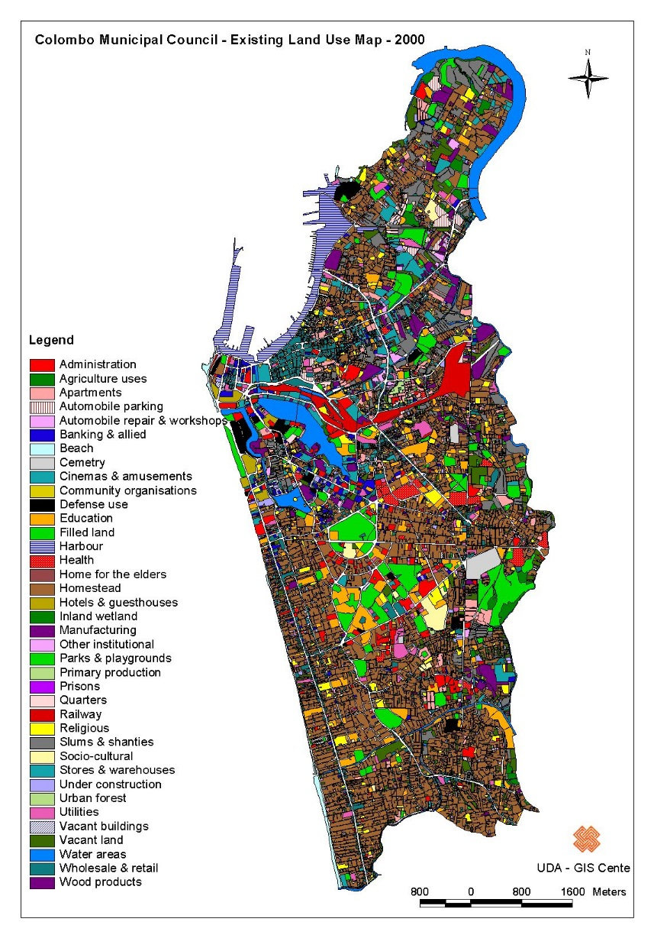
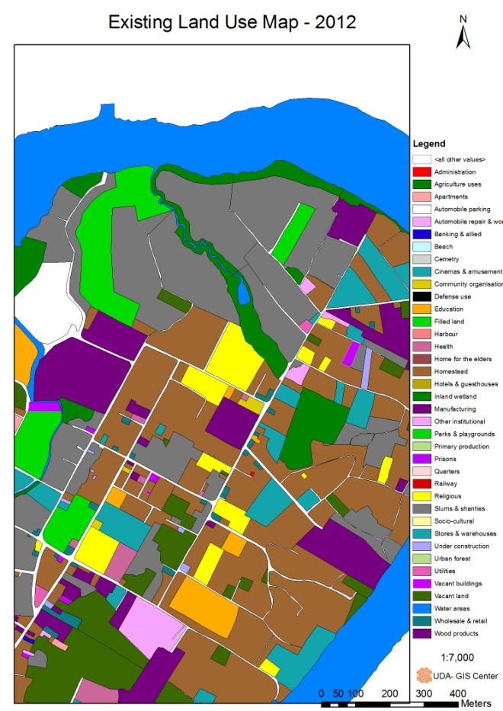
Existing Land Use

Slide 29
Name of the Land | Zone | Land Ownership | No of Families | Land Extent | Existing land Use | Availability of Infrastructure
Samitpura | Port related Activity Zone | NHDA | 1300 | 12.47 Ac | Residential + commercial There were good houses | Water and drainage facilities are available in that land
Pichchamalwatta | Port related Activity Zone | Private | 150 | 3.46Ac | Residential | Water, drainage and sewerage facilities are available
Gamunupura | Port related Activity Zone | SLRDC | 86 | 3.47Ac | Residential | Water, drainage and sewerage facilities are available
Sriwickramapura | Port related Activity Zone | NHDA | 270 | 5.02Ac | Residential | Water, drainage and sewerage facilities are available
Rawatta | Port related Activity Zone | Private | 57 | 2.22Ac | Residential - This area was affected by Tsunami | Water, drainage and sewerage facilities are available

Slide 30
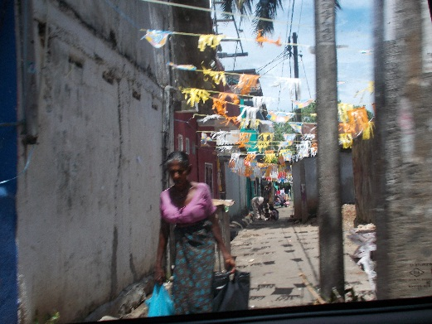
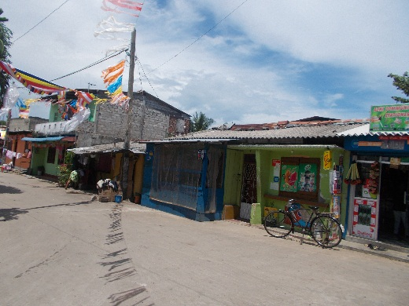
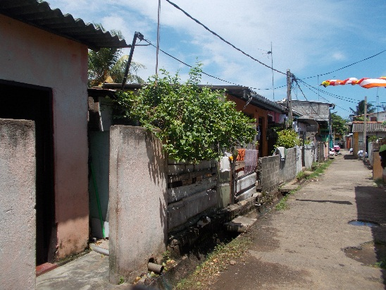
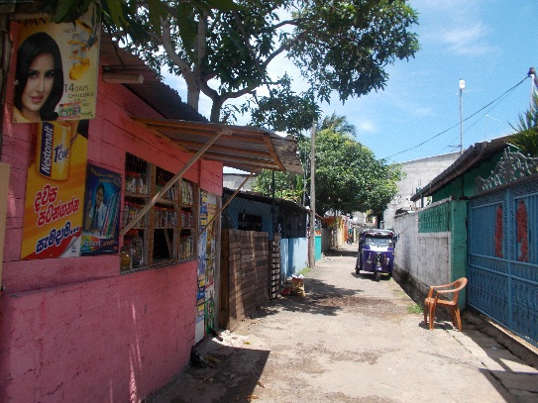
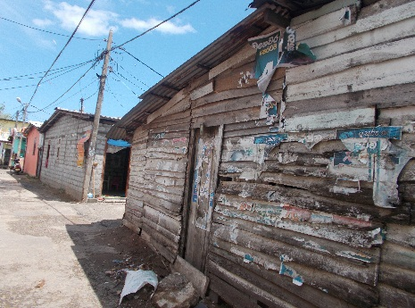
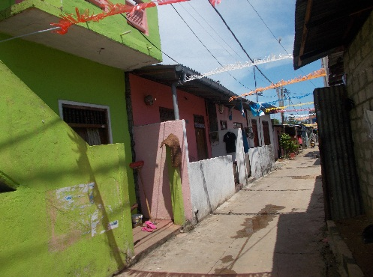
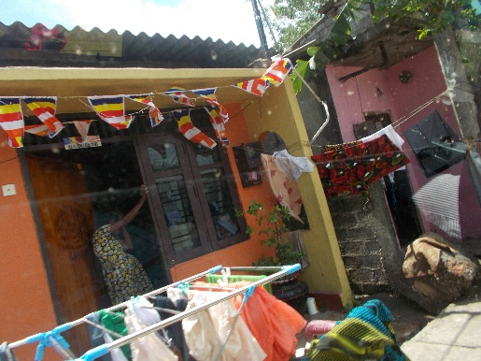
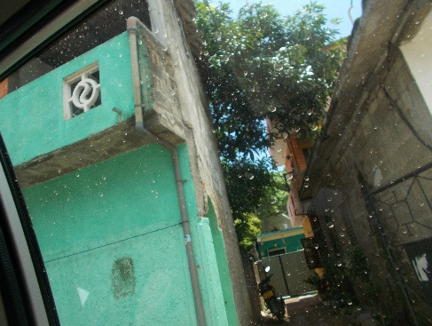
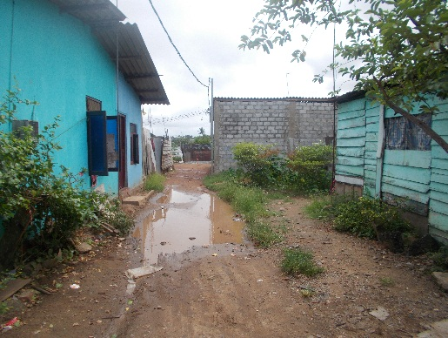
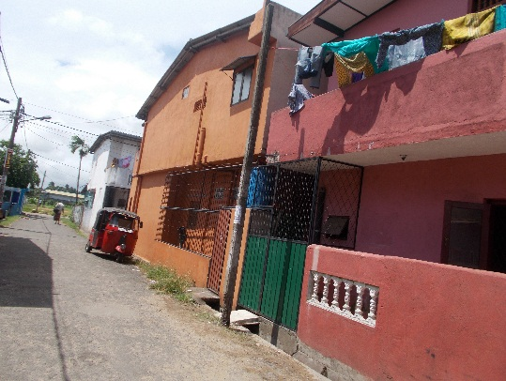
Back ground of the Study Area
Samitpura
Pichchamalwatta
Gamunupura
Sriwickramapura
Ra watta

Slide 31
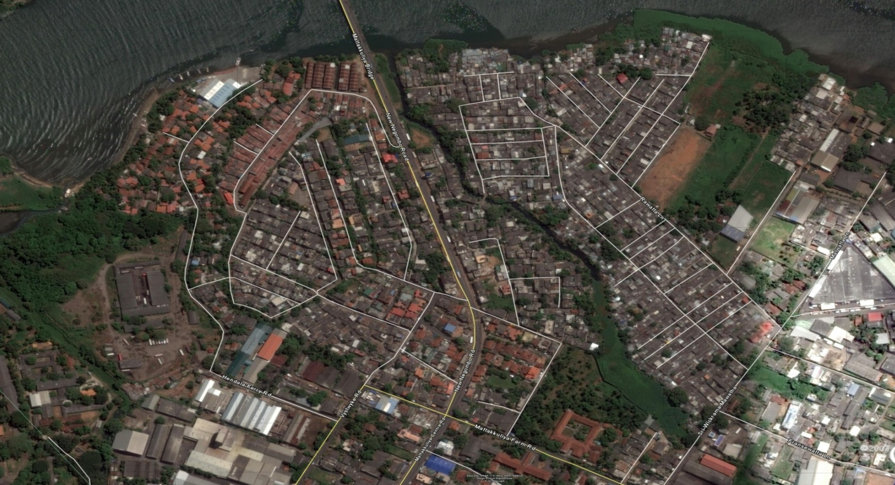


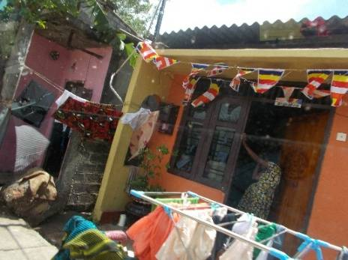
Why we need to plan there?....
Preserving or improving land and buildings in an area
Rehabilitating buildings in an area
Removing unwanted buildings from an area
Constructing or replacing buildings in an area
Establishing, improving, or relocating roads, public utilities, or other services
Facilitating any other development in an area take maximum profit from those land.
Gemunupura
Sriwikramapura
Pichchamalwatta
Rawatta
Kirulakele
Kadiranawatta
Samithpura
Kadiranawatta
Ekamuthupura

Slide 32
This Lands have potential for…..
Negombo entrance Land mark
Proposed walking path With Green belt
Develop Star class hotel project.
Create a accessible road to Negombo- Colombo Main road and create a Land Mark
Create walking path along the Kelani river
Propose new road from henamulla to samitpura along the Kelani river reservation
Proposed Road

Slide 33
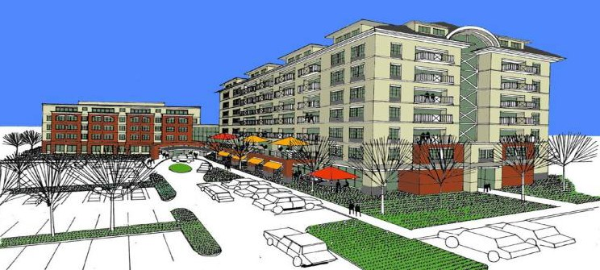
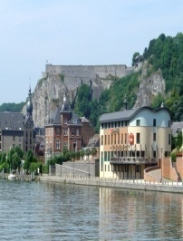

Proposal 1: Develop Star Class Hotel Project
Opportunities :
To investigate the Potentialities for the Tourism Development in the region.
Prevention and mitigation of Hap Hazard Development.
Enhance the Natural Resources
Development of Tourism Conducive to the Region to harness grater economic benefits .
Containment of Urban Growth.
Identifying the Environmentally sensitive areas and protection of the environmental features
Devising Strategies to mitigate the negative impact on the environment and the negative sociological implications which can in-filtrate in to the system.
Protecting the natural habitats, eco systems and the Sri Lanka’s rich bio diversity within the region with the developments due to commence thereby creating a healthy built environment.
Empowering the local community
Infrastructure development

Slide 34
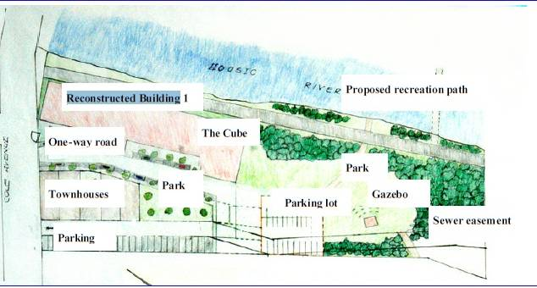
Infrastructure
- On-site sewage & waste water treatment, solid waste management
- Power Supply and Water Supply
- Improvement to road network
- Carefully integrated service and drainage lines/structures
- Cleaning and enhancement of existing water body and creation of public linear park around it

Slide 35
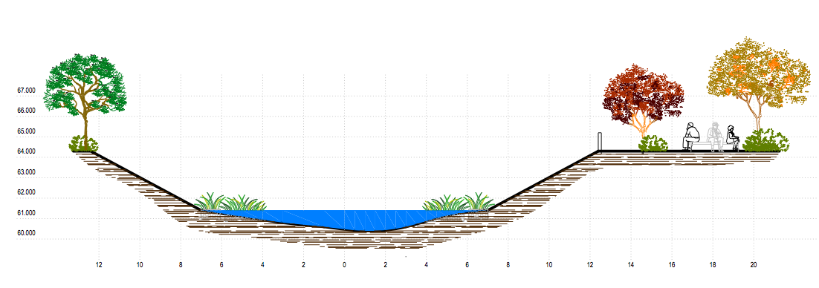
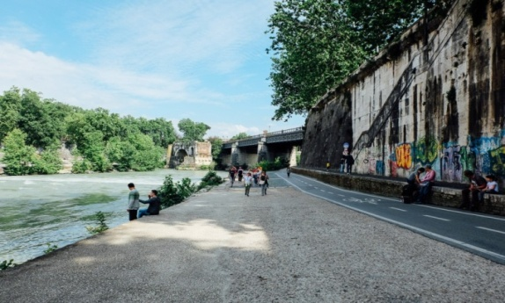
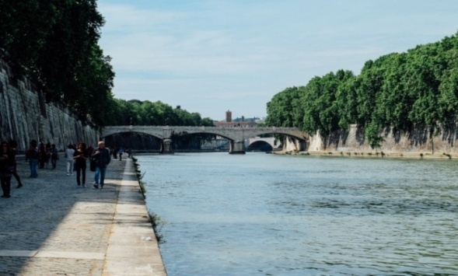
Proposal 2: Create walking path along the Kelani river
Improve access to the Negombo new road
Improve public paths through samit place to provide interest and variety, including a circular walk.
Provide a good quality footpath as an alternative to the cycle path.
Protect river reservation
Proposed walking path with Green Belt
Proposed Road

Slide 36
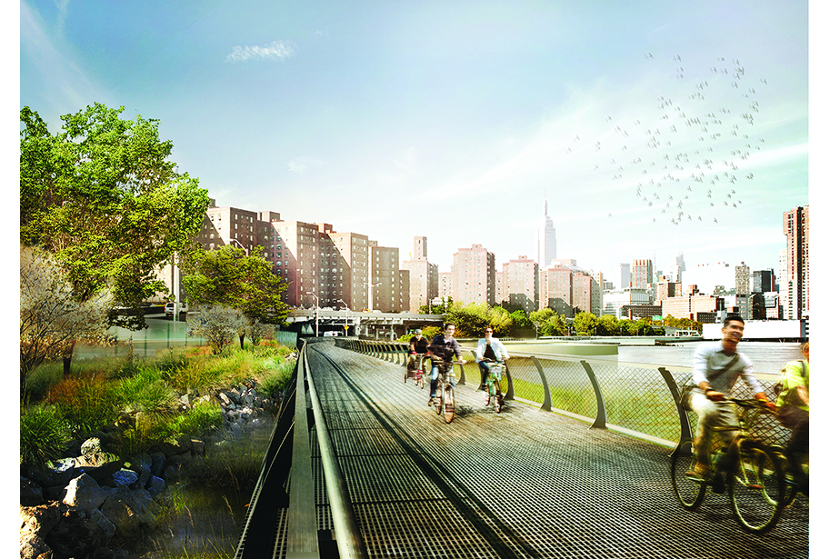
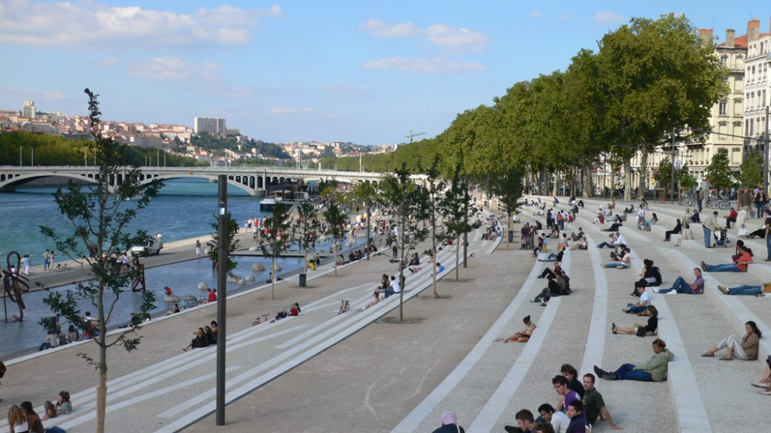
Proposal 3: Planning For The Waterfront Area
Comprehensive Plan to “redevelop the waterfront area by maximizing the Kelani River as defining visual, open space and recreational amenity, while at the same time promoting mixed-use development that will supply economic support to the community.”
The objectives for the waterfront area :
Maximizing public enjoyment of the waterfront.
Making a destination for low-impact boating and other water-oriented uses.
Providing amenities, services, and attractions that will draw people to the waterfront.
Ensuring environmentally smart development.

Slide 37
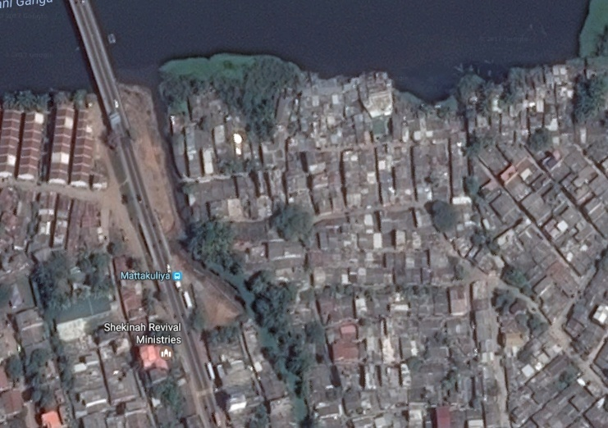
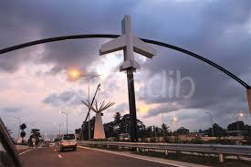
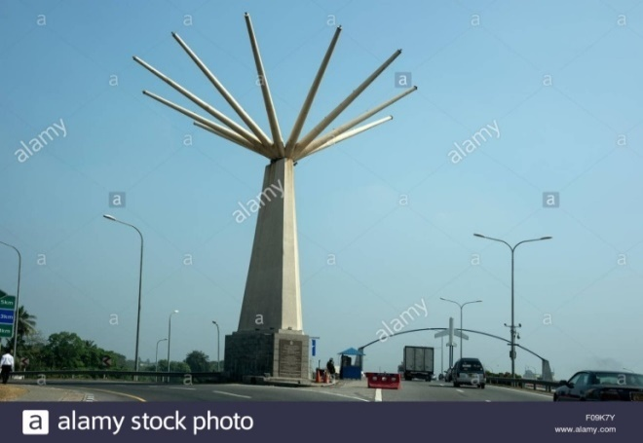

Proposal 4: Create a accessible road to Negombo new road and create a New gate way to Colombo North
Proposed Nodes
Proposed Road
reduce friction of distance ( Improve Accessibility)
facilitate trade
improvement to movement of people and goods
contribute to remove barriers and led to an overall better standard of living

Slide 38

Proposal 5: New road from Henamulla to Samitpura along the Kelani river reservation
Facilitate linkage with the Negombo road
Control the traffic in the existing roads.
High connectivity to the land and people interaction

Slide 39

Layout Plan
2.7 A
4.3 A
2.7 A
3.1 A
5.8 A
3.5 A
2.4 A
4.9 A
3.4 A
4.3 A
Total Area = 35.5 A

Slide 40
Logistic Park - Ekala
Action Project, Urban Design & Phasing Plan
Proposed Site: Ekala SLBC Lands/ Adjoining Land
Extent : 82 Acres
Proposed Activities :
Warehouses
Storage facilities
Container depot,
Cooling facilities,
Freight Forwards Zone,
Consolidation
Light industries cluster
Administration Centre
Security Office
Banking ,Financial Service Area
Research & Development Centre
Fuel/Gas Station
Vehicle Maintained Centre- Work Shop
Waste Water Treatment Plant
Fire Fighting/ Rescue Facilities
Medical Centre
Education & Training Centre
Parking Facilities
Grid Substation
Hotel, Restaurants
Convention Centre
Railway Terminal /multimodal centre
Container Handling Facility
Security & Custom Clearance facilities
Warehouses / Storage facilities
Weighing Centre
Office Space
Parking Facilities
Sewerage Pumping Station / Treatment Plant
Strom Water Retention Ponds
Water Treatment Plant / Water Storage Tank
Solid Waste Management

Slide 41
Multimodal centre- Ragama
Action Project, Urban Design & Phasing Plan
Proposed Sites: Ragama Railway station, Bus
terminal, Market area
Extent : 16 Acres
Proposed Activities :
Integrated of Bus terminal, Station
building, Commercial activities, parking
facilities , taxi park

Slide 42
Intended Developments
Logistic Park –Meethotamulla

Slide 43

Thank you…

